Slide 1

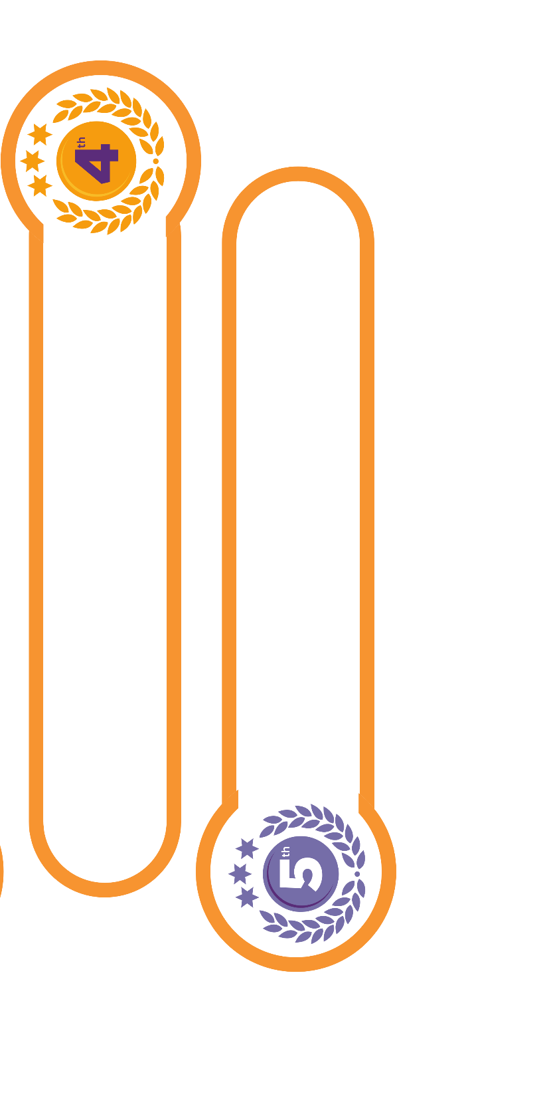
[Name of School]
[10,000] questions in total have been answered this [week].
Well done, [School name]
[9U1 – 2,000 questions]
[8X2 – 3,986 questions]
[9X1 – 3,863 questions]
[7U2 – 4,146 questions]
[9X2 – 3,861 questions]

