Slide 1

An introduction for parents & carers
www.educake.co.uk
01865 800808
support@educake.co.uk

Slide 2

What is Educake?
Educake is a website for homework, classwork and revision
Teachers can set students homework
Students can set themselves revision quizzes
Can be used on smartphones, tablets, and computers
www.educake.co.uk

Slide 3
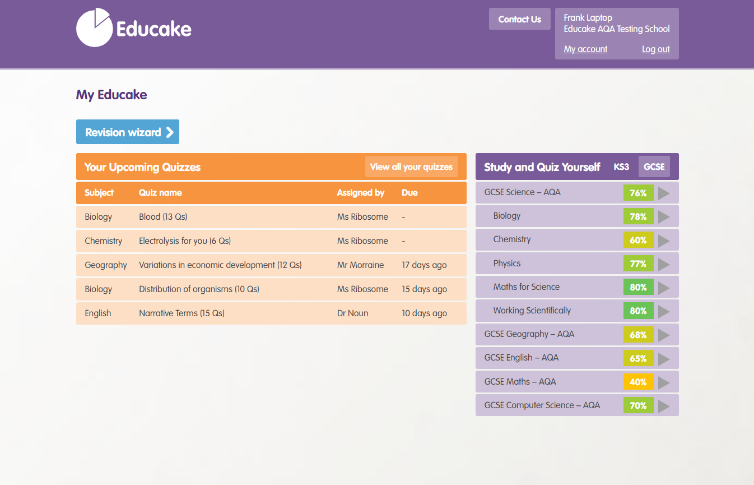
Completing homework and classwork
Quizzes set by teachers are in orange.
Students click on a quiz to answer
the questions.
www.educake.co.uk

Slide 4
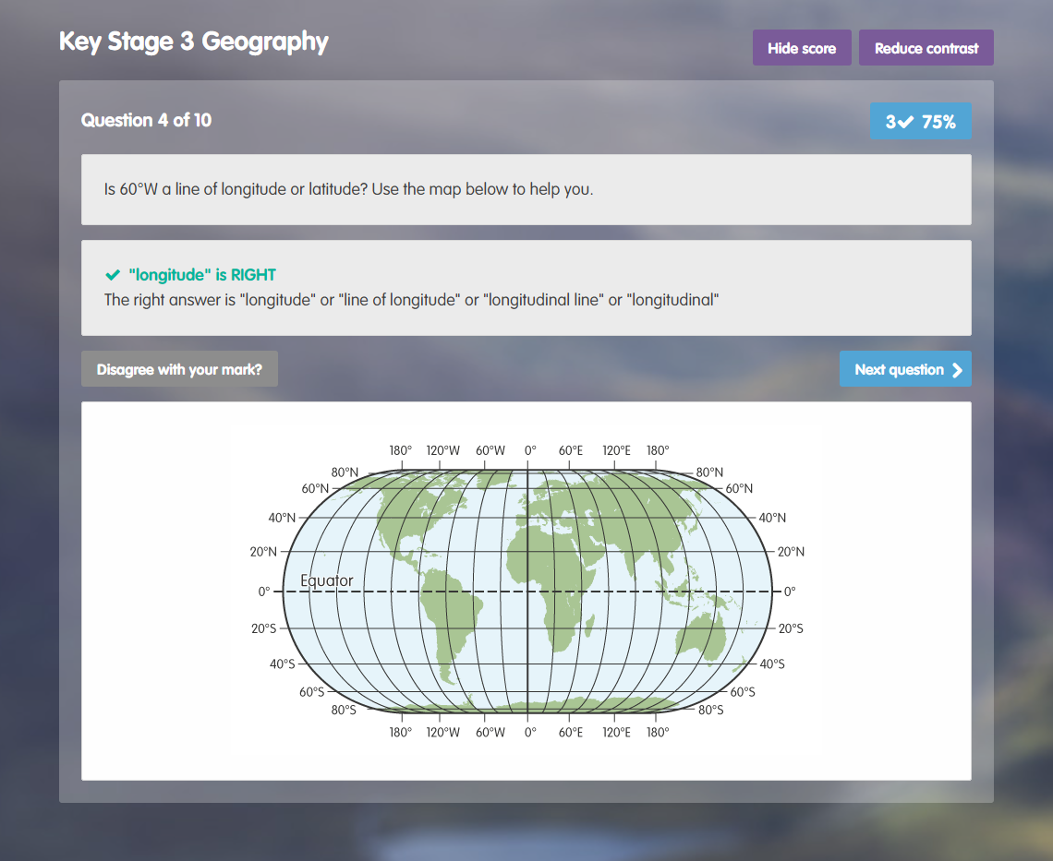
What are Educake quizzes like?
After they answer a question, they get feedback straight away.
They can also query a question with their teacher by clicking on “Disagree with your mark?”
www.educake.co.uk

Slide 5
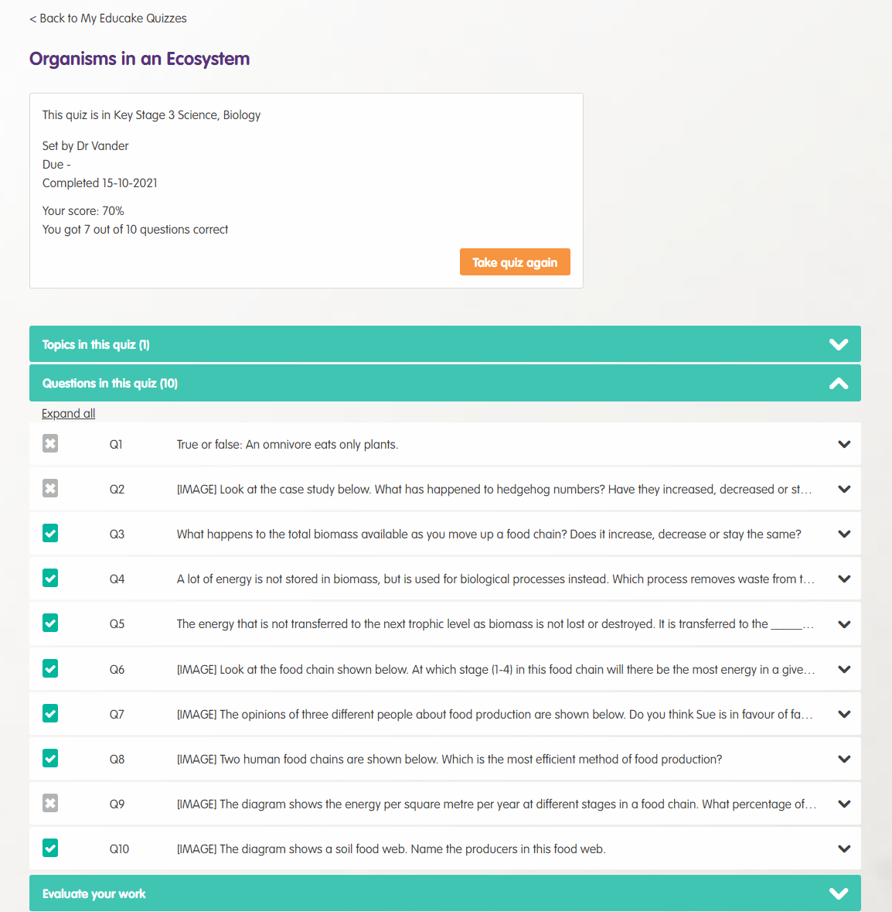
What are Educake quizzes like?
Students can view results when they complete a quiz.
They can also take a quiz again.
www.educake.co.uk

Slide 6
Viewing progress
They can see their subjects here:
Subjects they know well are green.
Subjects they need to revise are red.
They can click on a subject to see its topics in more detail.
www.educake.co.uk

Slide 7
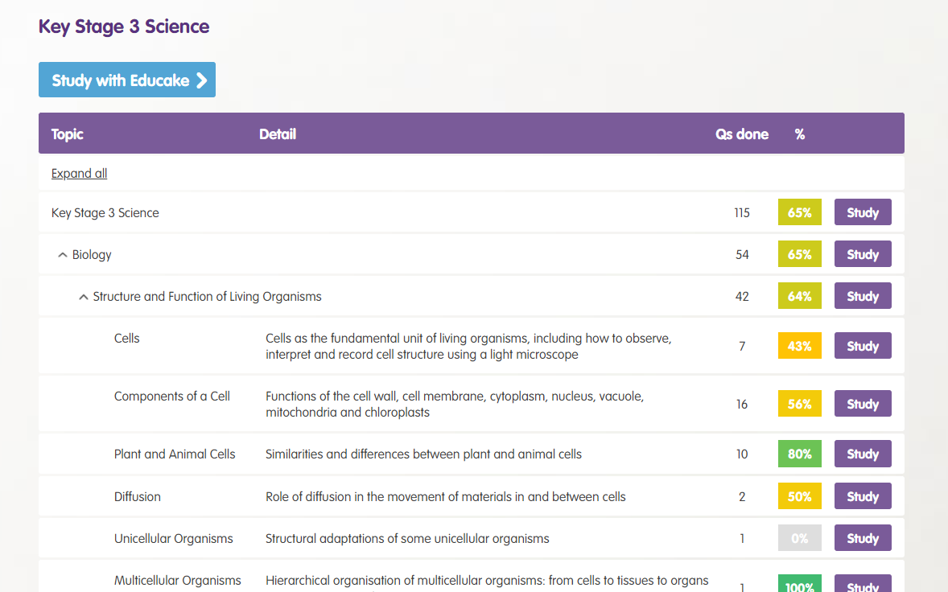
Revising
When they click on a subject, they’ll see a list of all its topics.
Topics they know well are green.
Topics they need to revise more are red or orange.
Clicking “Study” next to the topic lets them revise it:
www.educake.co.uk

Slide 8
Revising
If they don’t know where to start, Educake will suggest a quiz for them.
This is called the Revision Wizard.
www.educake.co.uk

Slide 9
To sum up Educake
Teachers can set students quizzes.
Students can set themselves quizzes.
Educake shows them which areas you know and which areas they need to revise.
Educake is designed for regular, bitesize practice. The more they answer questions, the better they will learn.
www.educake.co.uk

Slide 10
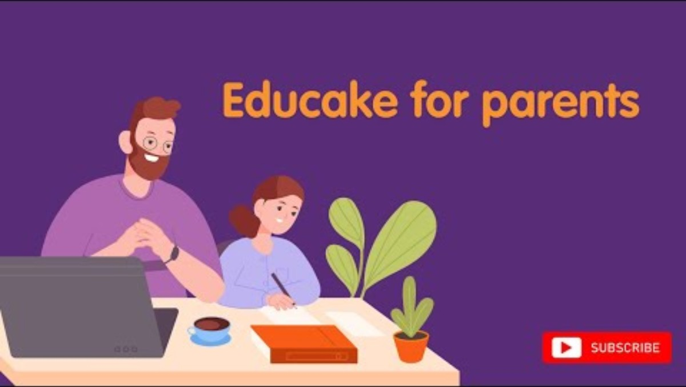

Slide 11
[Subject] homework at [school name]
[Example – edit to suit your department’s plan]
Years 7-9: 20 questions/week
Years 10-11: 30 questions/week
1 in 3 quizzes is a repeat of a previous one
Students must retake the quiz until they reach a score of at least 80%. Only then will homework be considered complete.
www.educake.co.uk

Slide 12
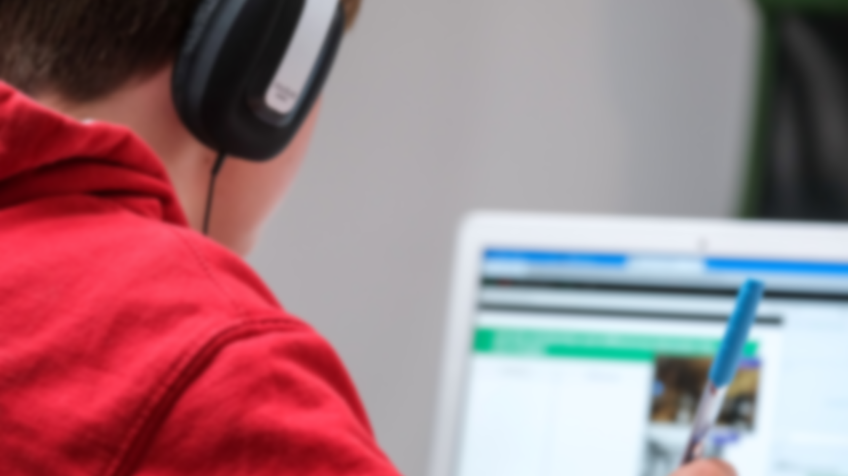
Rewards for answering extra questions on Educake
[Example – edit to suit your department’s plan]
There will be a monthly leaderboard in the [subject] corridor showing the top 5 classes and students in terms of questions answered.
The top class each month gets a pizza party, and the top students get a gift card/cupcake + a certificate sent home.
Top 3 students answering the most questions in a term will receive an award at end-of-term assemblies.
www.educake.co.uk

Slide 13
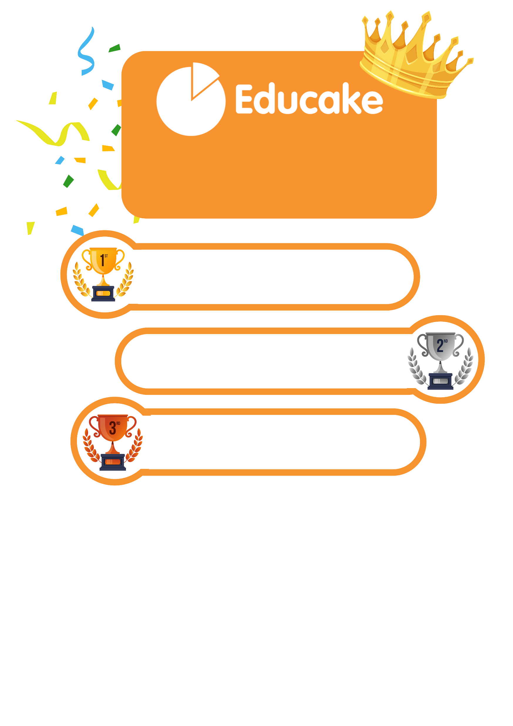
[Name of School]
[10,000] questions in total have been answered this [week].
Well done, [School name]
[Student – 4,146 questions]
[Student – 3,986 questions]
[Student – 3,863 questions]

Slide 14
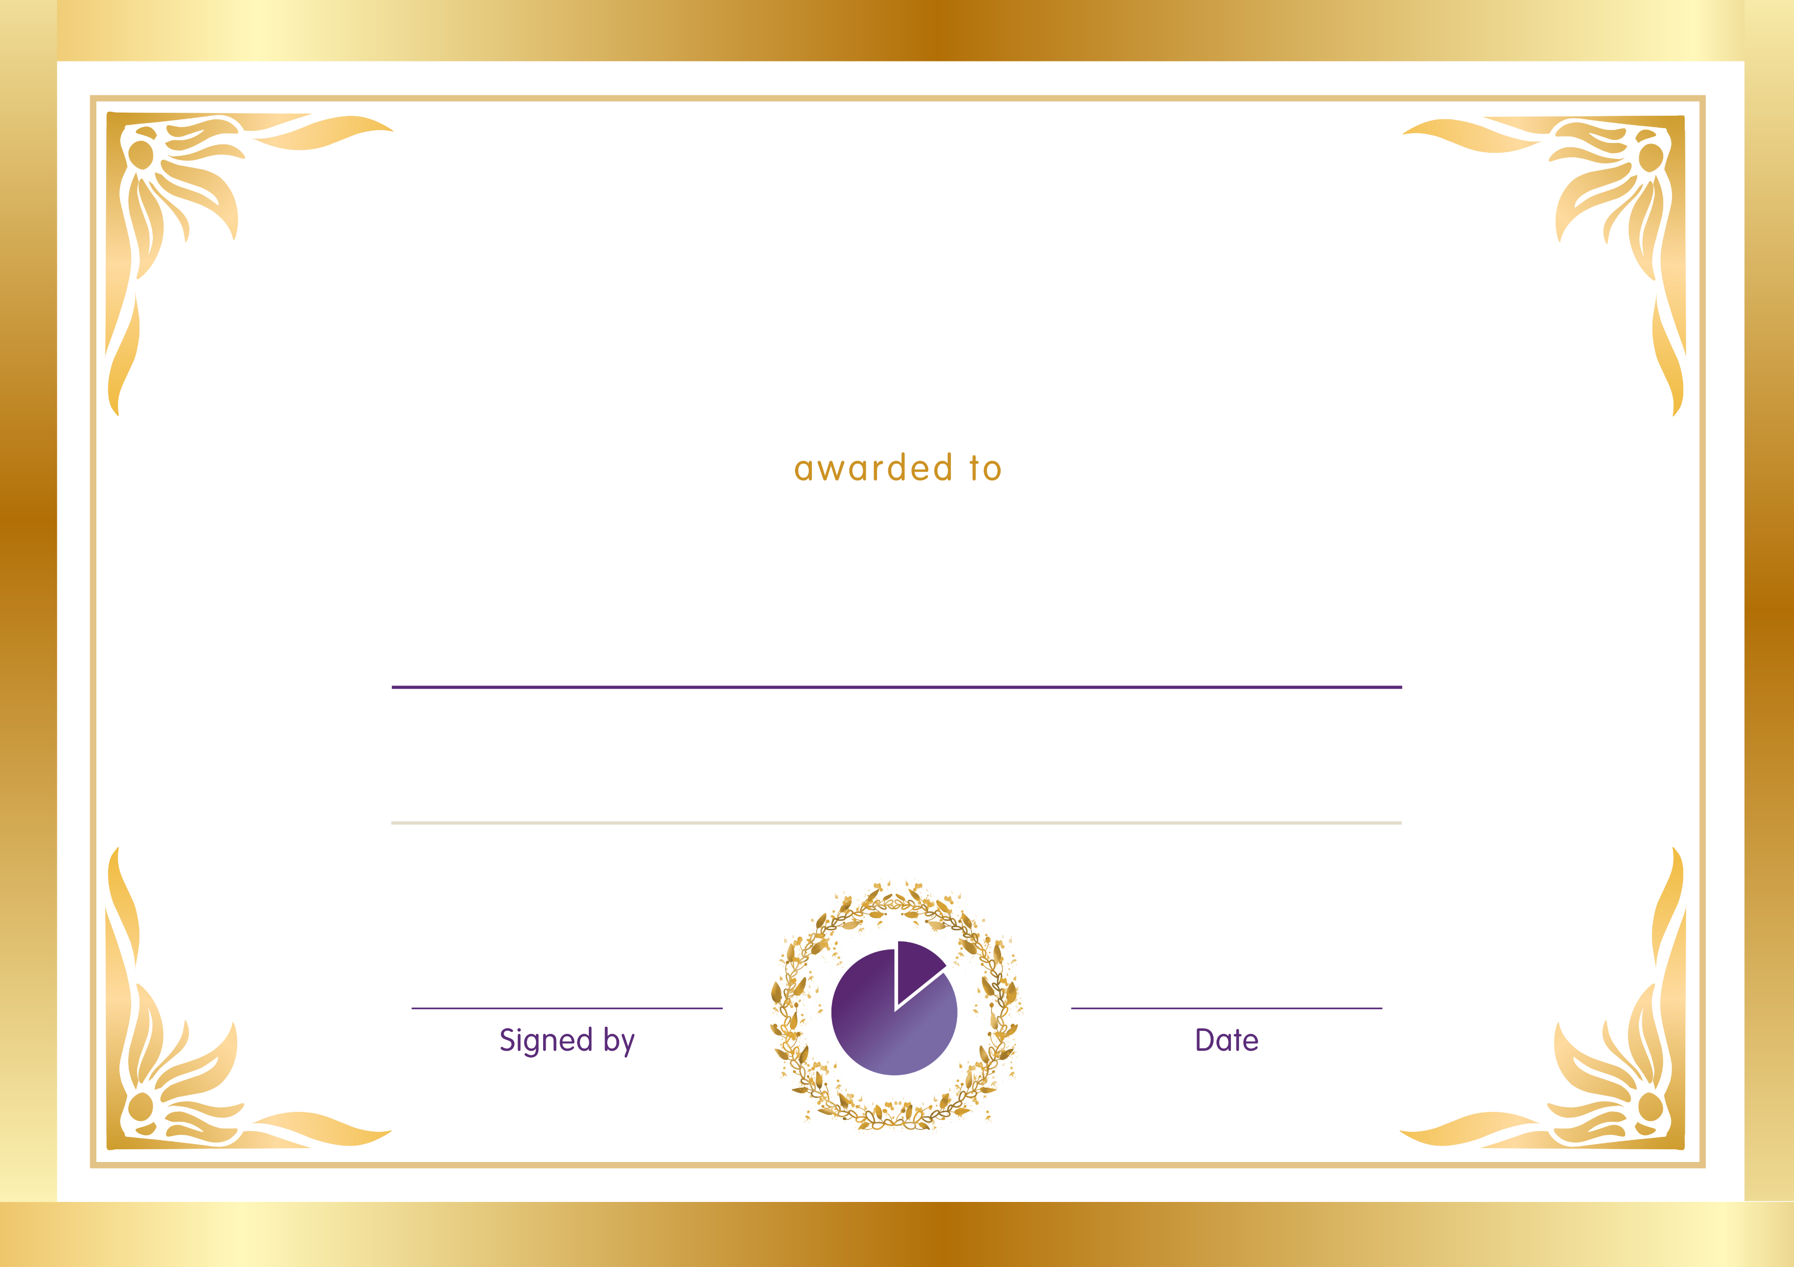
Educake Certificate
of Achievement
[Student Name]
[School Name]
[Signature]
[00/00/00]

