Slide 1
Revise and you could win a prize!
Three lucky students who use Educake to revise this April will win a £50 One4all gift card (for use at 130+ retailers in store and online) in a random prize draw.
Just log in to Educake and set yourself 100 questions throughout the month of April. You don’t have to answer them all at once – space them out!
If you do this, you will automatically enter the draw.
Good luck with your revision!

Slide 2
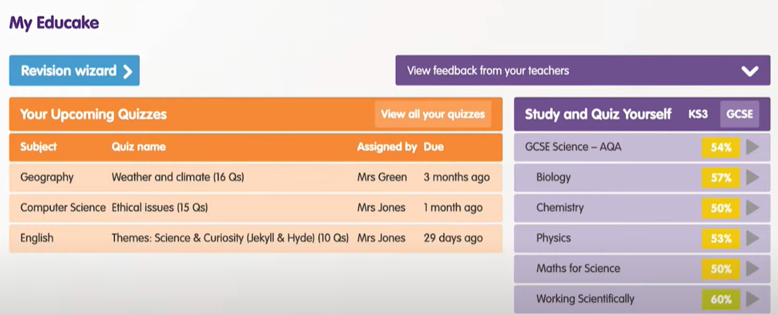
How do I set myself a quiz?
Only questions you set yourself will count towards the 100. There are two ways to set yourself quizzes: Revision Wizard and Study and Quiz Yourself

Slide 3
Using Educake
Notes:
Youtube link: https://www.youtube.com/watch?v=7BDh9YLf2Fg

