Slide 1

Educake Pupil Guide
www.educake.co.uk

Slide 2
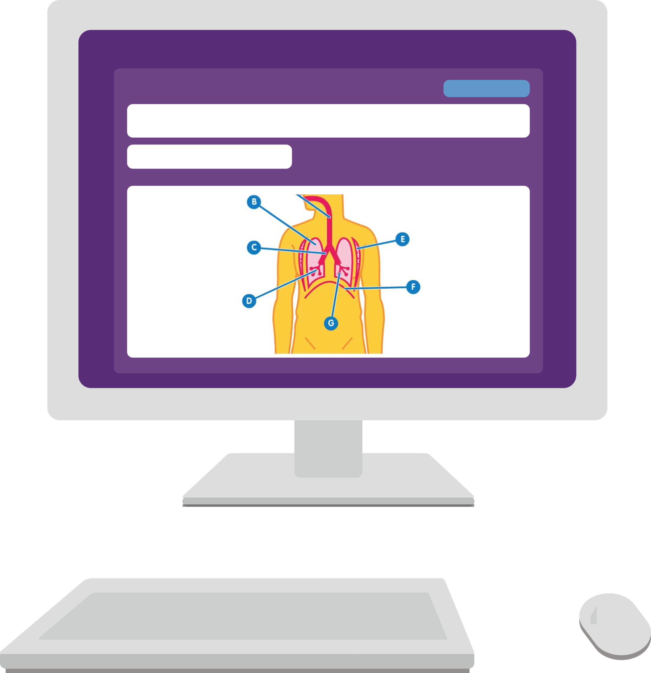
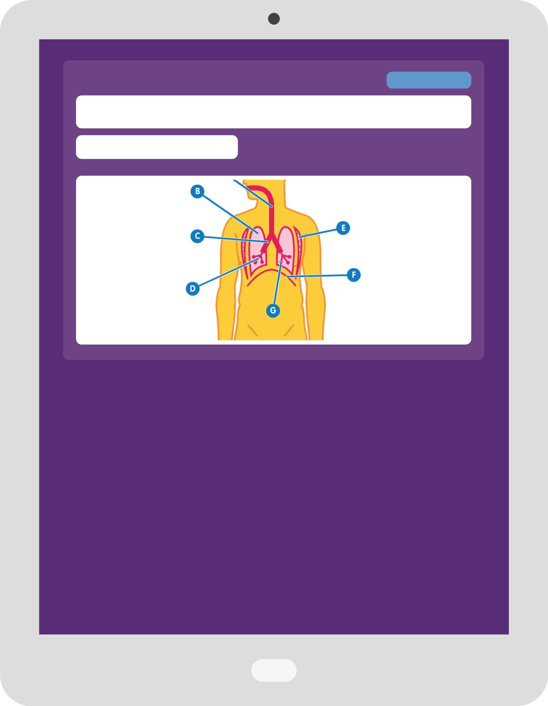
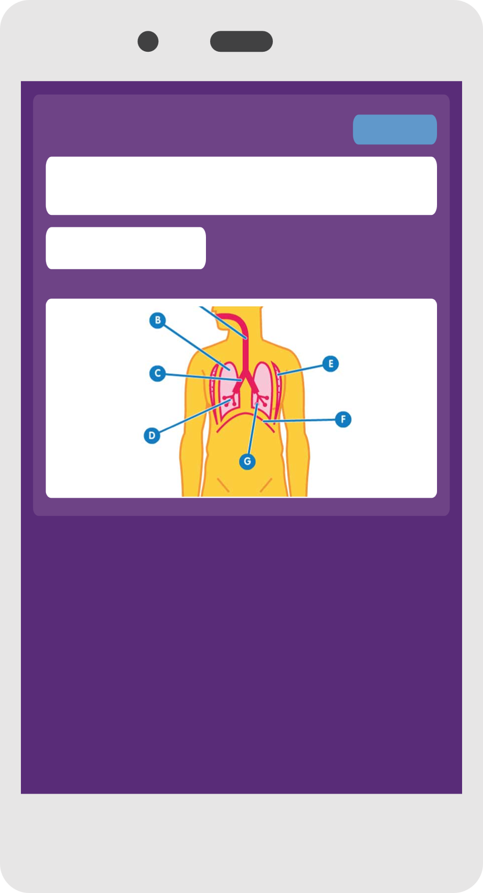
What is Educake?
Educake is a website for practising your learning.
Teachers can set you quizzes.
You can set yourself quizzes.
You can use Educake on smartphones, tablets, and computers.

Slide 3
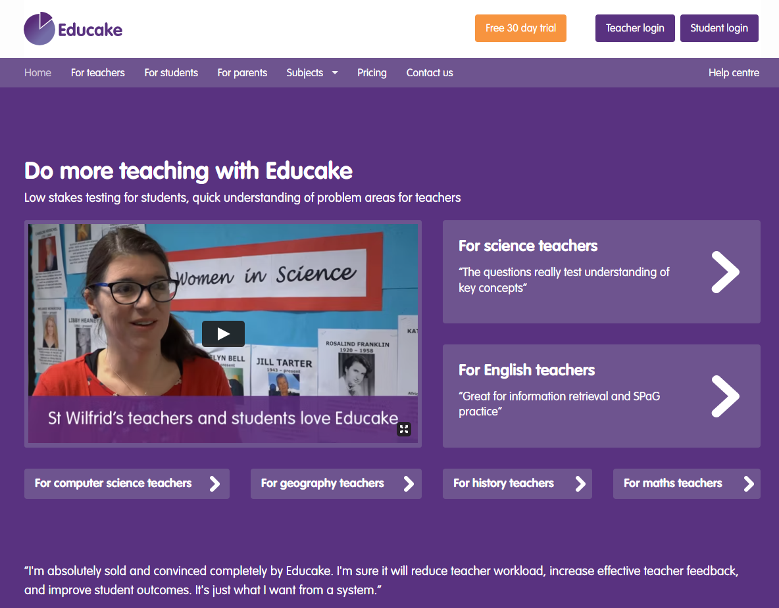
How do I log in to Educake?
Go to www.educake.co.uk.
Click on the “Student login” button.
Type the username and password your teacher gives you.
Your username is:
first name + first letter of your last name + a four digit number
For example, Brian Pie’s username is brianp0009.

Slide 4
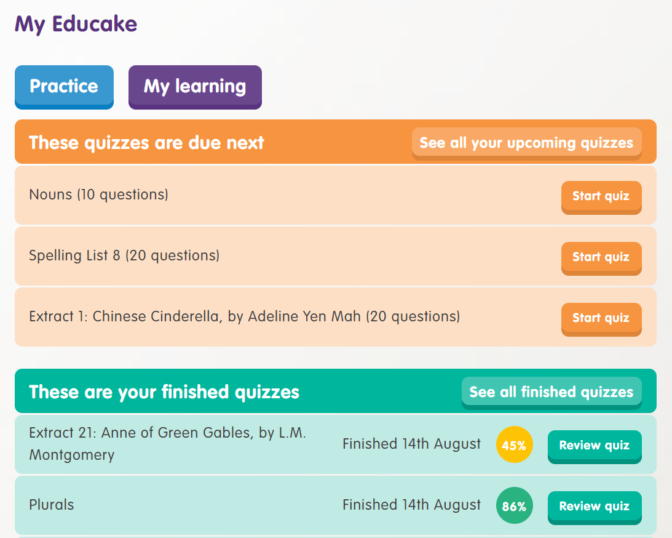
How do I do quizzes?
Quizzes that your teachers have set you are in orange.
Click on a quiz to answer
the questions.

Slide 5
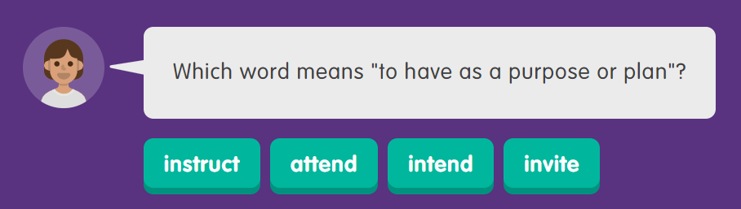
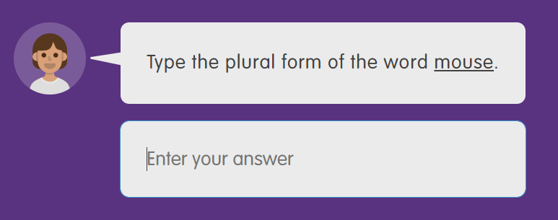
What are Educake quizzes like?
Educake quizzes are made of
short questions.
For some questions, you need to click on an answer.
For other questions, you need to type in an answer.
You can make small spelling mistakes for some questions, but you should try to learn the correct spelling.

Slide 6
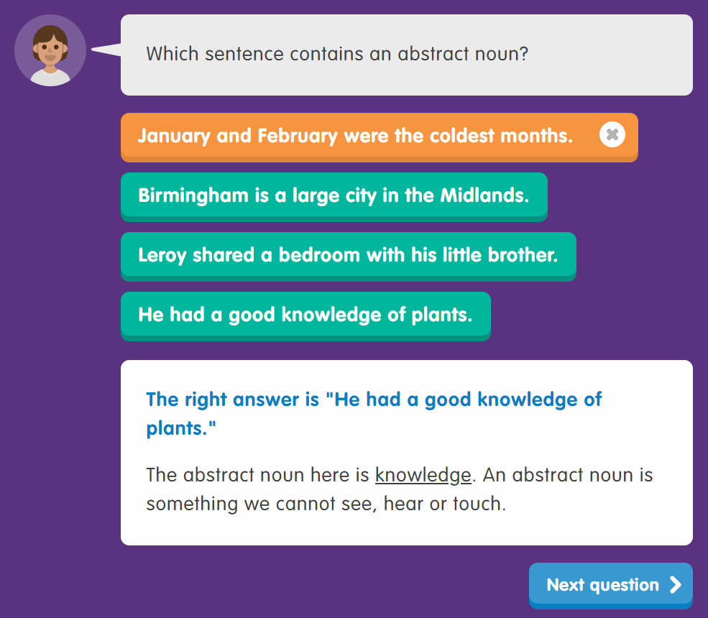
What are Educake quizzes like?
After you answer a question, you get feedback straight away.

Slide 7
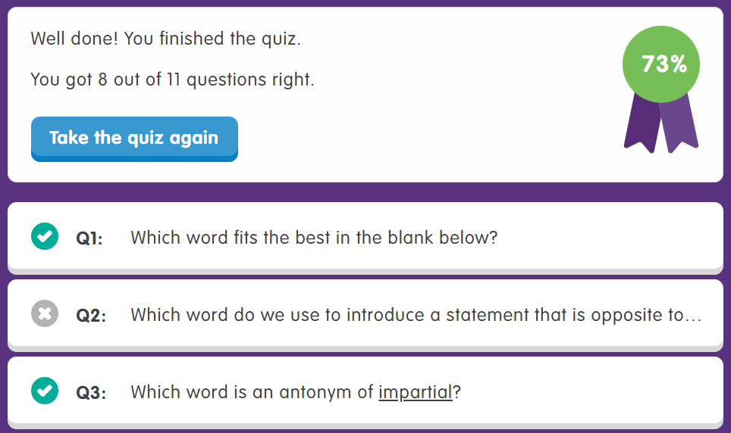
What are Educake quizzes like?
When you finish a quiz, you can
see your results.
You can take the quiz again here:

Slide 8

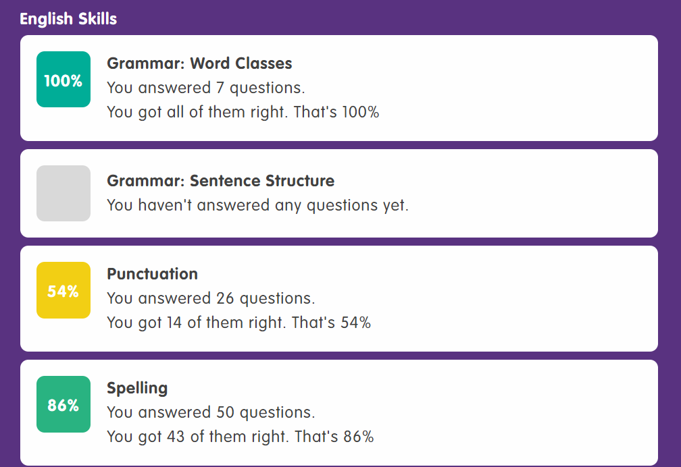
How can I see how well I’m doing?
You can view your progress by clicking on “My learning”.
Topics that you know well are green.
Topics that need some practice are yellow or red.

Slide 9
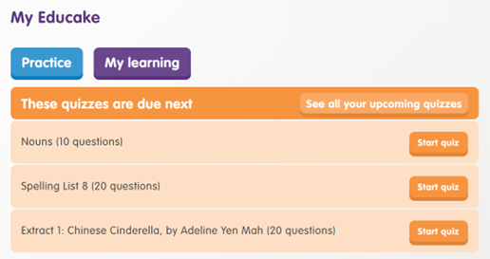
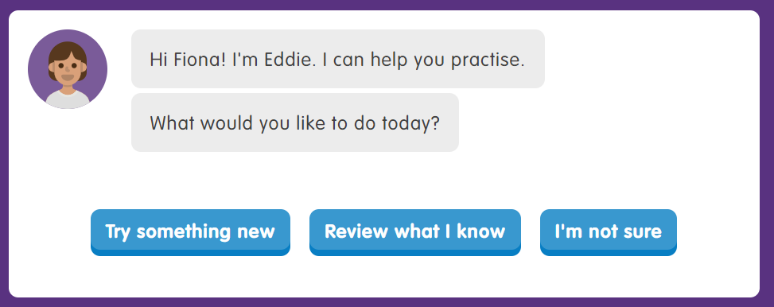
How do I practise on my own?
Eddie can help choose practice questions for you.
Click on the blue button here:
You can try something new, review what you know, or let Eddie pick.

Slide 10
To sum up Educake
To sum up Educake:
Your teachers can set you quizzes.
You can set yourself quizzes.
Educake shows you which areas you know and which areas you need to practise.
Keep practising! The more you answer questions, the better you will learn.

